Slide 1
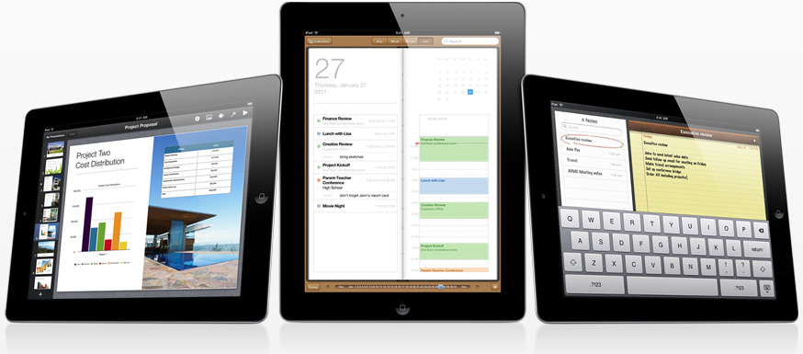
Apple iPad
Ready for Business?
Michael Hyde
IT Manager
Northern Neck Electric Coop
Warsaw VA

Slide 2
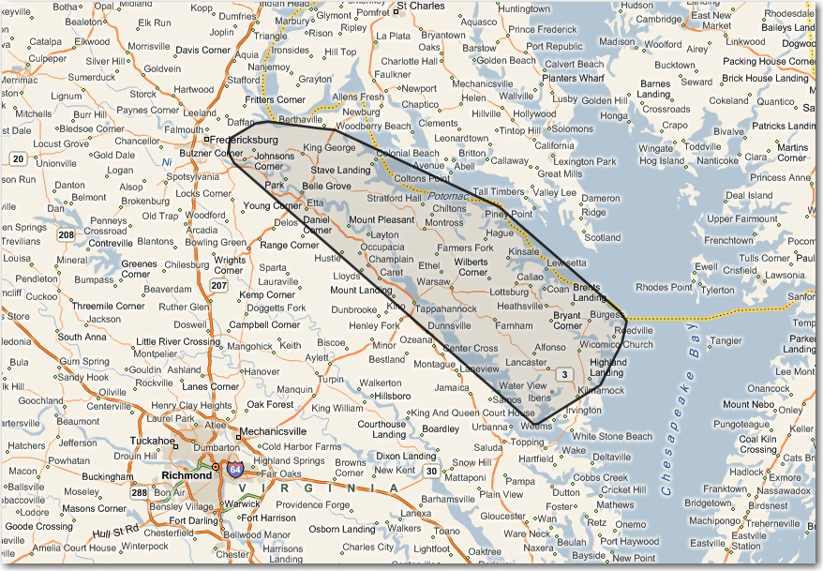

Northern Neck Electric Cooperative
18,500 Meters
6 Counties
Systems:
Daffron
Milsoft
Aclara
Partner
ESRI
Survalent

Slide 3
NNEC Strategic Plan
Mobile Workforce (2006)
Objective: To evaluate and recommend implementation process for mobile data communications
Feedback was requested from Operations, Customer Service, Engineering
Real Time Access:
CIS
Email
Internet
Network Files
Intranet (NNECDAS)
Daily Updates
Mapping

Slide 4
Mobile Data Requirements (Strategic Action Plan 2006)
 | Customer Service | Engineering | Operations
CIS Data | Yes | Yes | Yes
Email/Calendar | Yes | Yes | Yes
Intranet | Yes | Yes | Yes
Mapping/Viewer | Yes | Yes | Yes
Meter Ping/Read | Yes |  | Yes
Damage Assessment |  |  | Yes
Outage System |  |  | Yes
Network Files/Programs | Yes | Yes | Yes
Printing/Copy |  | Yes
AVL (Crews) |  |  | Yes
Cameras | Yes | Yes

Slide 5

Mobile Data - 2006
Deployed 12 Laptops (Dell Latitude D610) into vehicles
Maintained 1 for spare
Loaded Partner Map Viewer
Installed wireless access points in pole yard for updates
Provided basic map viewer training to outside personnel

Slide 6
Mobile Data - 2007
4/3 - Obtained wireless card from Verizon for testing
4/7 – Obtained 4 wireless cards
Customer Service Field Representatives (CSFR’s) (3)
Serviceman (1)
5/15 – Installed 2 docking stations in Operations for map updates
6/7 – Obtained 3 more cards
Staker (1)
Serviceman (2)
7/7 – Obtained additional card for staker
7/23 – Provided Crew Mapping Training (2 hours)
8/10 – Obtained additional card for travel pool

Slide 7
Mobile Data - 2007
10/1 – Added 2 more docking stations in Operations.
10/1 – Moved spare laptop to Operations for check-out use. Will add additional spare in January.
12/1 – Updated meter change process to incorporate mobile data. This process virtually eliminates missed reads when meter changes are performed.

Slide 8
Mobile Data - Capabilities
Real time access to:
Map viewer
Customer Information System (CIS)
Incident Management System (IMS)
eMail/Calendar via Outlook
Ability to:
Query Account Information
Ping & Read Meters
Access Incident Management System
Do what they normally would from their desk

Slide 9
Mobile Data
External Costs:
Verizon Cards - $0
Antennas - $30 each
Monthly fee - $60/card

Slide 10
Mobile Data improvements
2009 Planned Enhancements
Printers (2 installed for testing)
Damage Assessment (Field/office synchronization)
Outage Assessment (Field/Office synchronization)
Line Inspection (Field/Office synchronization)
AVL (Thru new radio system)
More map viewer applications
Continue Computer Training for outside personnel
Projected Costs:
$ 5,000

Slide 11
Mobile Data improvements
2010 Planned Enhancements
Damage Assessment (Field/office synchronization)
Outage Assessment (Field/Office synchronization)
Line Inspection (Field/Office synchronization)
Continue Computer Training for outside personnel
Transition from Wireless cards (PCMCIA) to Mi-Fi’s
Laptop replacement

Slide 12
Laptop Replacement
Standard Laptops
Cheap
Windows
Ruggedized Laptops
Costly
Windows
Diskless Laptops (ie. Kanguru)
Tablets
Upcoming mobile device?

Slide 13


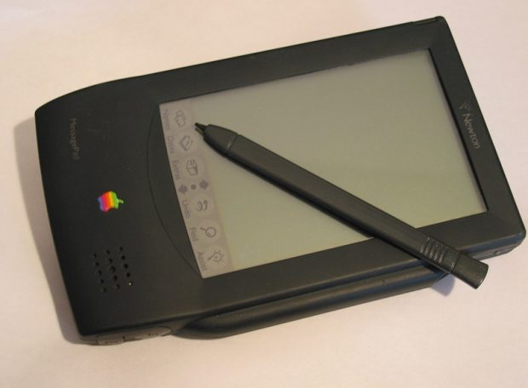
Tablet Computers History
The Telautograph, invented by Elisha Gray in 1886, allowed an operator to duplicate a handwritten message over wire.
In 1961, researchers create the RAND Tablet, the first two-dimensional writing surface that allows humans to commuicate instantly with computer through characters printed on a tablet.
The Apple Newton was an early PDA and the first commercial foray into tablet computing from Apple.

Slide 14
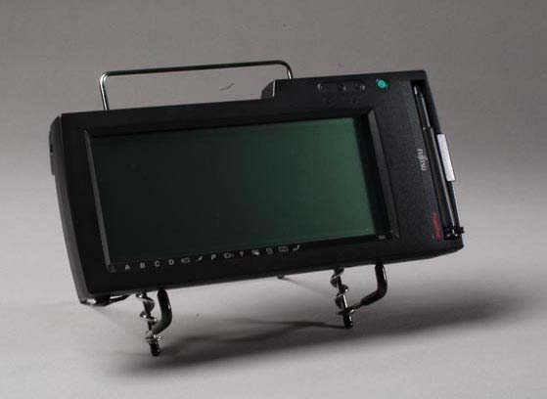
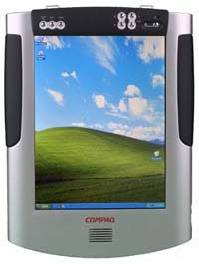
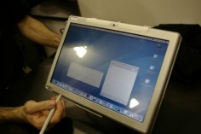
Tablet Computers
In 1991 the Poqet Computer Corporation, in partnership with Fujitsu, introduced the PoqetPad: a handheld, touch-screen computer with an NEC V20 CPU chip running at 7 MHz.
In 2001, Microsoft attempted to once again move into the personal computing device market with devices like the Compaq Tablet PC; packing the full Windows XP operating system into a handheld unit. It never took off.
The Axiotron Modbook is an aftermarket modification of existing MacBooks.. Send them your MacBook, and they would rebuild it as a tablet.

Slide 15
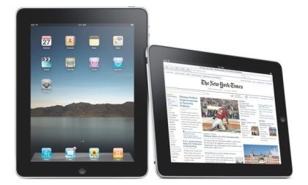
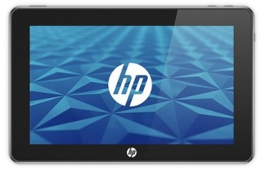
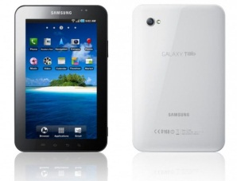
Tablet Computers
In April of 2010, Apple introduced the iPad, a tablet-sized variation of the iPhone. Apple had been originally developing the iPad, but decided to bring the phone to market first instead. It has set the standard for modern day tablet computing
HP's foray into the tablet market, backed by Microsoft. After over a year of delays and supply difficulties, the HP Slate 500 was intoduced to positive reviews and yawns from the consumers. The existing iPads and Android tablets had already eaten what little market share they could have gleaned. Users still feel the full desktop OS is not appropriate on a tablet.
The first Android tablet from a major technology manufacturer, the Samsung Galaxy Tab has sold very well. Only time will tell if Google and Android have the capability to grab the top spot in tablet computing the way they have with smartphones.

Slide 16
iPad vs. Laptop
iPad
Laptop
Quick boot
Battery Life - ~~10 Hours
Weight – 1.5 Lbs
Portability – Carry anywhere
Virus
Applications
Versatile
Multi-device
Updates (OS & App)
Secure?
Internal Camera (2)
Even a cave man can use it
Slow boot
Limited battery life
Still fairly heavy
Fairly portable
Constant concern
Install from anywhere/one
Long time market share
Very versatile
Updates sometimes painful
Secure?
Training, training & training

Slide 17
iPad for Personal Use
What do I use my iPad for?
Email (work & personal)
Calendar
Contacts
Car GPS
iPod
Boat GPS (Electronic charts)
Movies (House, boat, plane)
Digital picture frame
Find places (Chic-fil-a, Starbucks…)
Remote Control (TV, Satellite, DVR)
Monitor energy usage
News (magazines, newspapers)
Track kids (Facebook)
Start/unlock my car (On-star)
…

Slide 18
iPad in Business
A whole new kind of device for business.
iPad is the best way to collaborate with colleagues, deliver and display presentations, and access, create and share business information. The large, high-resolution display allows your users to see their work like never before. iPad is incredibly thin and light, and provides instant-on access at the press of a button, so work is almost always at-hand.
The Multi-Touch screen on iPad is incredibly precise and responsive, which allows your users to work using just their fingers, with little need for training or support. And with up to ten hours of battery life, iPad is always ready to work whenever your users are.

Slide 19
iPad in Business
Integrates with business.
iPad integrates with Microsoft Exchange, Lotus Domino and standards-based messaging environments, to provide your users push email, calendar and contacts, right out of the box. And iPad supports the most common corporate VPN and Wi-Fi protocols for secure access to your company’s networks.
iPad integrates with your company’s existing infrastructure thanks to built-in support for key enterprise technologies. Get secure access to email, calendar, and contacts via Exchange ActiveSync or open standards like IMAP, CalDAV and CardDAV. With support for IPSec and SSL VPN and WPA2 Enterprise Wi-Fi, users can also connect to private corporate networks.

Slide 20
iPad Security
Considerations:
• Device Security: Methods that prevent unauthorized use of the device
• Data Security: Protecting data at rest, even when a device is lost or stolen
• Network Security: Networking protocols and the encryption of data in transmission
• Application Security: The secure platform foundation of iOS
http://images.apple.com/ipad/business/docs/iPad_Security.pdf

Slide 21
iPad Security
Device Security
Establishing strong policies for access to iPad is critical to protecting corporate information. Device passcodes are the front line of defense against unauthorized access and can be configured and enforced over-the-air. iPad uses the unique passcode established by each user to generate a strong encryption key to further protect mail and sensitive application data on the device. Additionally, iPad provides secure methods to configure the device in an enterprise environment where specific settings, policies, and restrictions must be in place. These methods provide flexible options for establishing a standard level of protection for authorized users.
Passcode Policies
A device passcode prevents unauthorized users from accessing data stored on iPad or otherwise gaining access to the device. iOS 4 allows you to select from an extensive set of passcode requirements to meet your security needs, including timeout periods, passcode strength, and how often the passcode must be changed.
The following passcode policies are supported:
• Require passcode on device
• Allow simple value
• Require alphanumeric value
• Minimum passcode length
• Minimum number of complex characters
• Maximum passcode age
• Auto-lock
• Passcode history
• Grace period for device lock
• Maximum number of failed attempts

Slide 22
iPad Security
Remote Wipe
iPad supports remote wipe. If a device is lost or stolen, the administrator or device owner can issue a remote wipe command that removes all data and deactivates the device. If the device is configured with an Exchange account, the administrator can initiate a remote wipe command using the Exchange Management Console (Exchange Server 2007) or Exchange ActiveSync Mobile Administration Web Tool (Exchange Server 2003 or 2007). Users of Exchange Server 2007 can also initiate remote wipe commands directly using Outlook Web Access. Remote wipe commands can also be initiated by Mobile Device Management solutions even if Exchange corporate services are not in use.

Slide 23
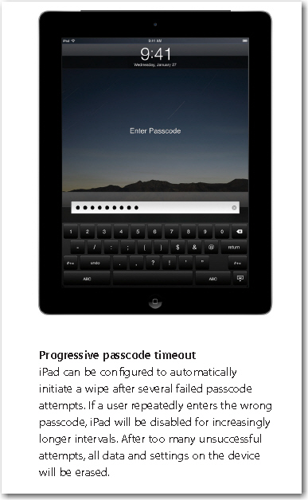
iPad Security

Slide 24
iPad Security
VPN
Many enterprise environments have some form of virtual private networking established. These secure network services are already deployed and typically require minimal setup and configuration to work with iPad.
Out of the box, iPad integrates with a broad range of commonly used VPN technologies through support for Cisco IPSec, L2TP, and PPTP. Additionally, iPad supports SSL VPN through applications from Juniper, Cisco, and F5 Networks. Support for these protocols ensures the highest level of IP-based encryption for transmission of sensitive information.
In addition to enabling secure access to existing VPN environments, iPad offers proven methods for user authentication. Authentication via standard X.509 digital certificates provides users with streamlined access to company resources and a viable alternative to using hardware-based tokens. Additionally, certificate authentication enables iPad to take advantage of VPN On Demand, making the VPN authentication process transparent while still providing strong, credentialed access to network services. For enterprise environments in which a two-factor token is a requirement, iPad integrates with RSA SecurID and CRYPTOCard.
iPad supports network proxy configuration as well as split IP tunneling so that traffic to public or private network domains is relayed according to your specific company policies.
SSL/TLS
iPad supports SSL v3 as well as Transport Layer Security (TLS v1.0), the next-generation security standard for the Internet. Safari, Calendar, Mail, and other Internet applications automatically start these mechanisms to enable an encrypted communication channel between iPad and corporate services.
WPA/WPA2
iPad supports WPA2 Enterprise to provide authenticated access to your enterprise wireless network. WPA2 Enterprise uses 128-bit AES encryption, giving users the highest level of assurance that their data will remain protected when they send and receive communications over a Wi-Fi network connection. And with support for 802.1X, iPad can be integrated into a broad range of RADIUS authentication environments

Slide 25
iPad Apps - Connectivity
Wyse PocketCloud – (RDP, VNC, View)
RDP
TNS5250
View (VMware View)

Slide 26
iPad Apps - Storage
DropBox
iDisk
iWork

Slide 27
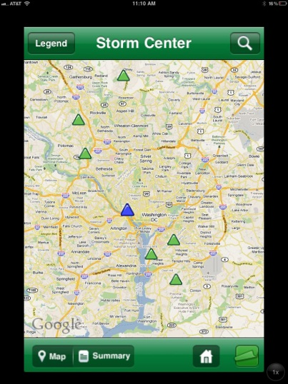
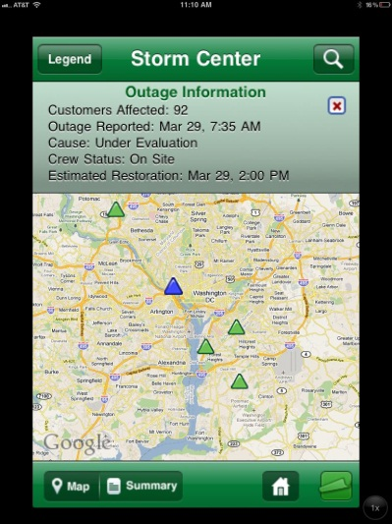
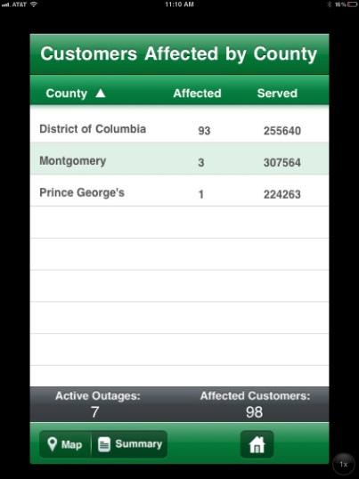
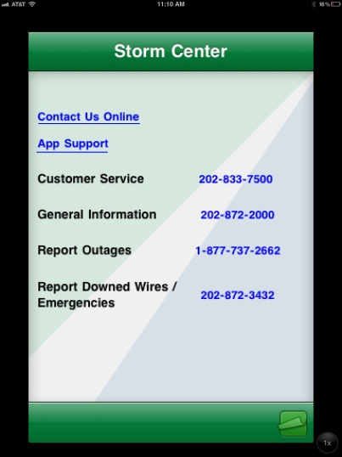
iPad Apps – Public Outage Map
PEPCO – Nice public outage map developed by iFactorConsulting for Pepco. They are also working on one for NISC customers.

Slide 28
iPad Apps – Internal Apps
Partner – Have a Damage Assessment, Outage and map viewer app for iPhone.
SEDC – Working on outage app.
NISC – Outage Map (via iFactorConsulting)

Slide 29
NNEC’s Plan (Testing 6/2010)
VNC – Accessed Terminal Server
TNS5250 – Access Daffron CIS
Wyse PocketCloud – Access internal Systems
VMware View – Access Virtual Desktops
Spiceworks – Access our Helpdesk

Slide 30
NNEC – Pilot Deployment
Have 11 iPad2’s on order thru Verizon
All are 32GB w/ 3G
Internet (3G or Mi-fi)
Deployment
2 - CSFR’s
4 - Duty Supervisors
1 - GM
2 – IT
2 - Managers

Slide 31
NNEC – iPad Management
iPhone Configuration Utility
JamF Software Casper Suite for IOS
Management of iTunes Accounts
Funding for business vs. personal apps

Slide 32
iPad as an IT Managers Tool
iPing
Vtrace
Speed Test
Spiceworks
iDashboards (Coming Soon)
VMware vSphere Client for iPad

Slide 33
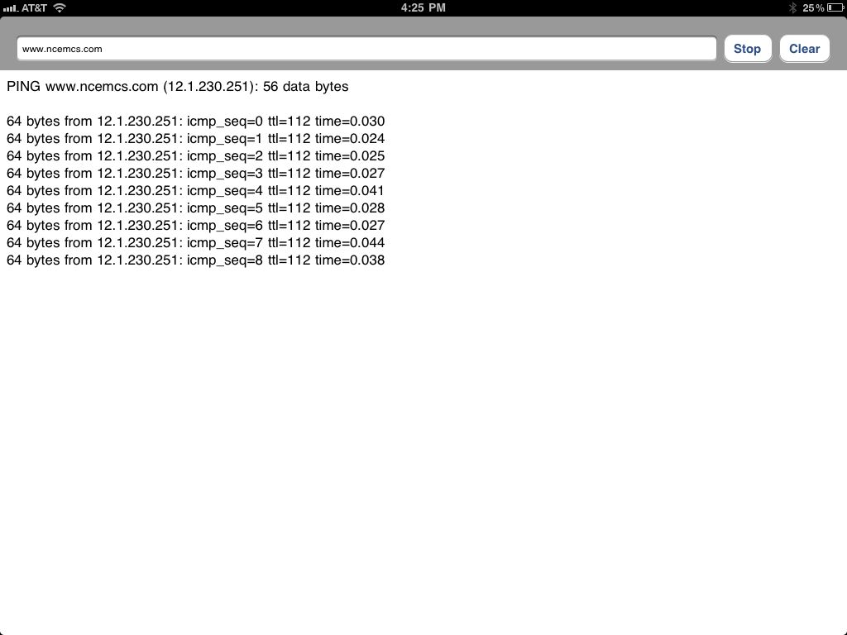
iPad as an IT Managers Tool
iPing

Slide 34
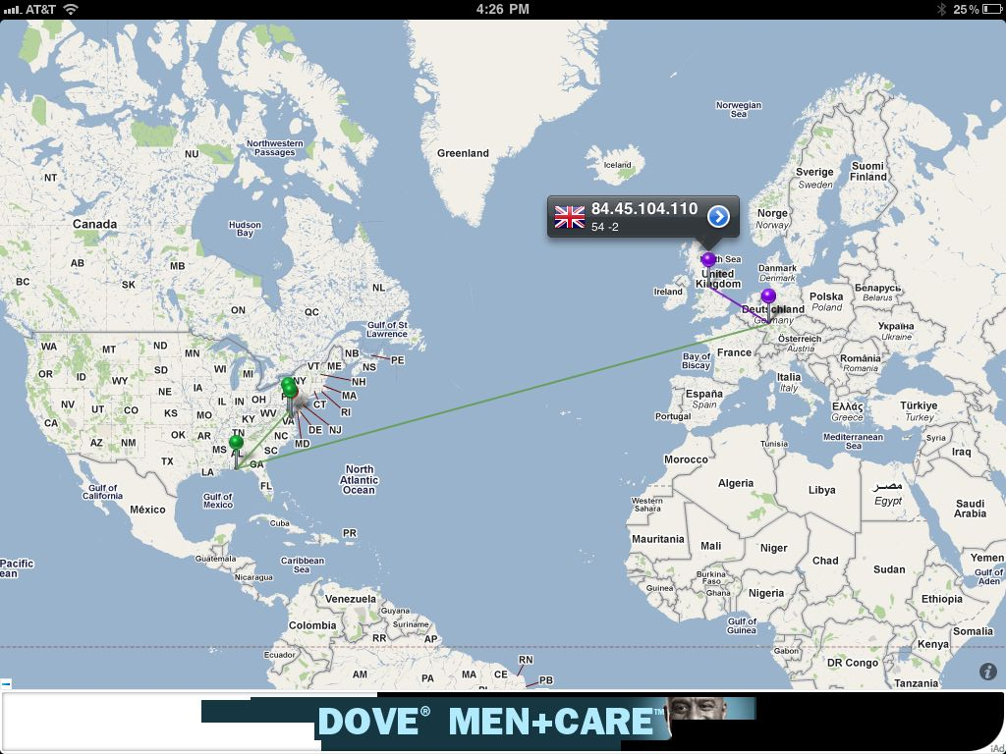
iPad as an IT Managers Tool
Vtrace

Slide 35
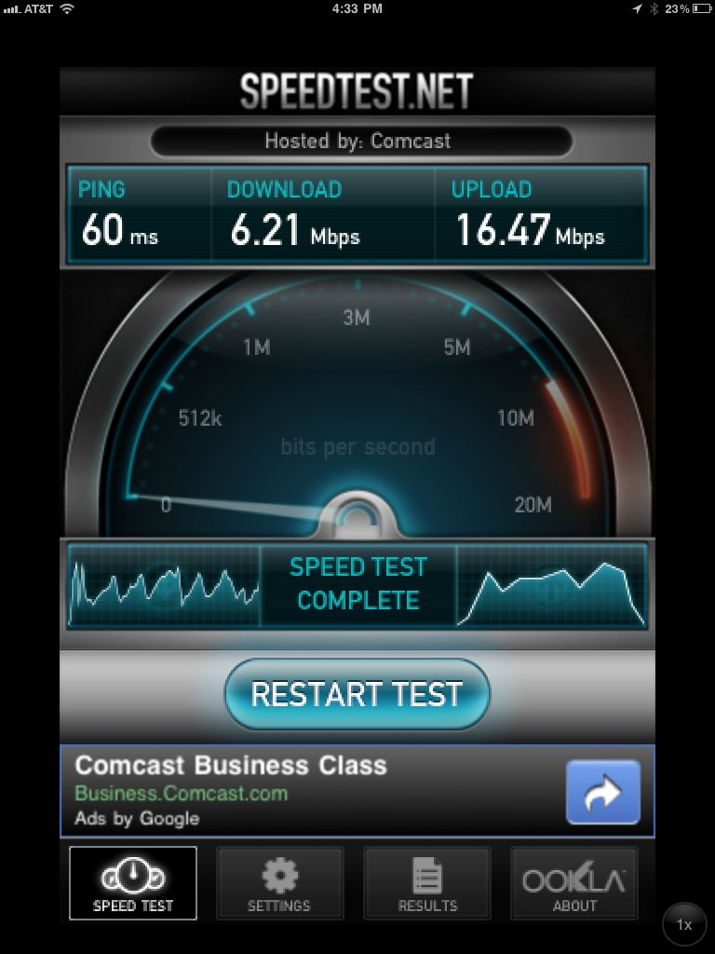
iPad as an IT Managers Tool
Speed Test
VMware vSphere Client for iPad

Slide 36
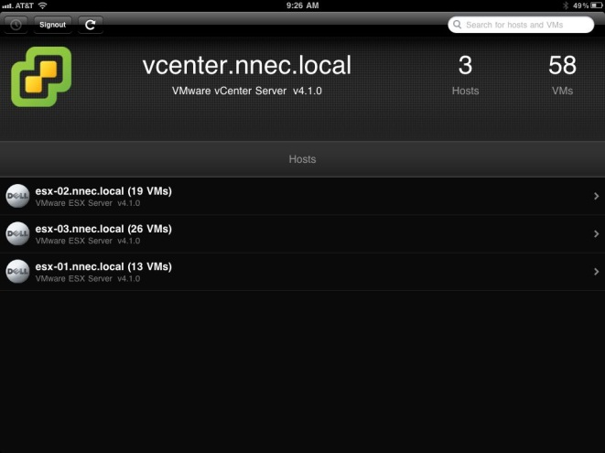
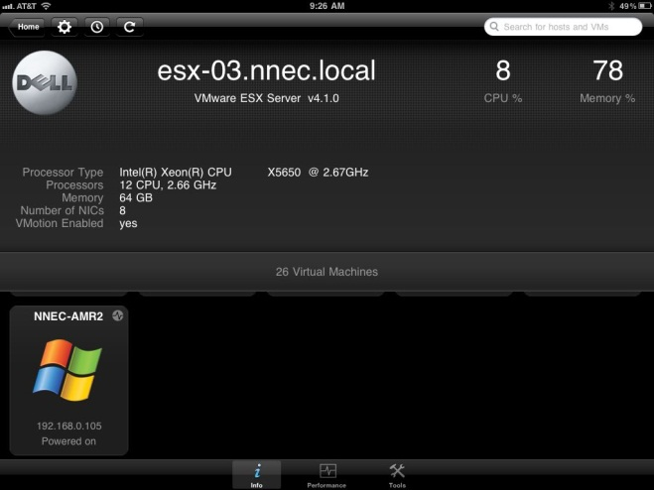
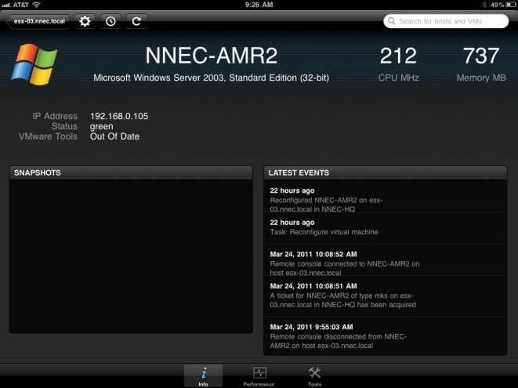
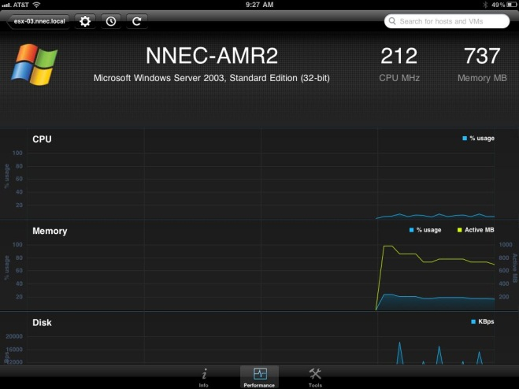
iPad as an IT Managers Tool
VMware vSphere Client for iPad (released 3/23/2011)

Slide 37
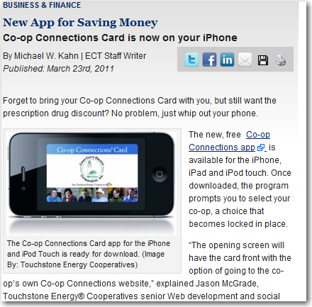
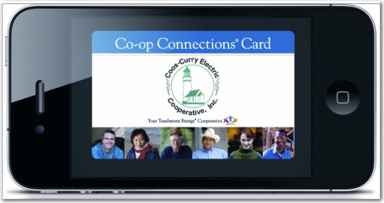
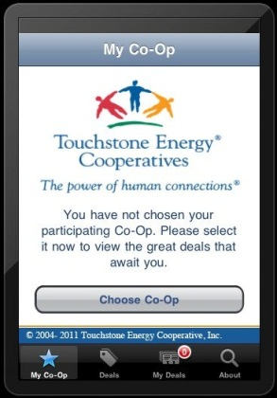
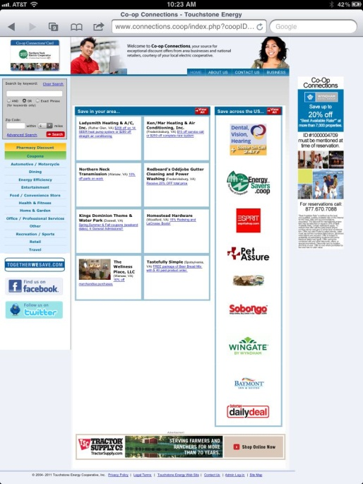
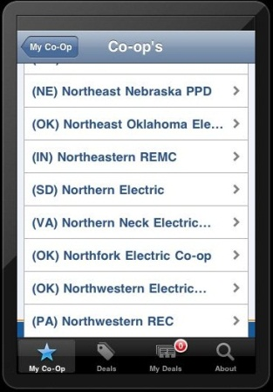
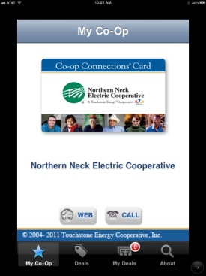
iPad as Member Tool
Co-op Connections card app (Released 3/23/2011)
http://www.ect.coop/industry/business-finance/new-app-for-saving-money

Slide 38
NNEC – iPad & Virtualization
PCOIP – Desktop Virtualization – Virtual Desktop
Virtual Desktops can be accessed by:
Windows Client
MAC Client
iPhone
Thin Client (Currently testing Dell FX100)
iPad via VMware View or Wyse Pocket Cloud

Slide 39
NNEC – iPad & Virtualization
PCOIP – Desktop Virtualization – Virtual Desktop
Thin Client (Currently testing Dell FX100)
Ability to run Windows
Unique IP
Audio
USB
Multiple Monitors
Speed – VD’s run on ESX server, utilizing SSD drives

Slide 40

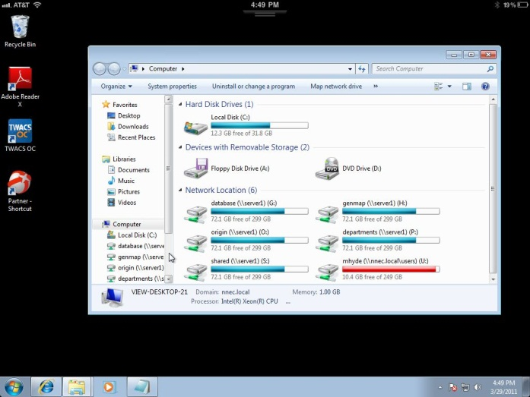
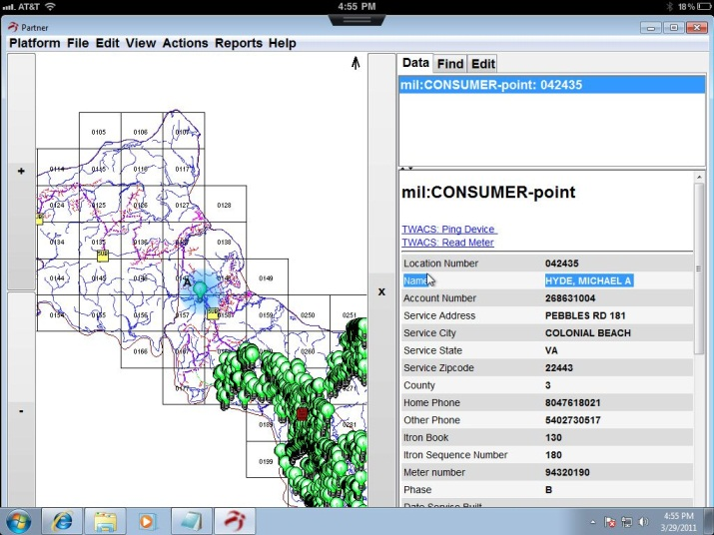
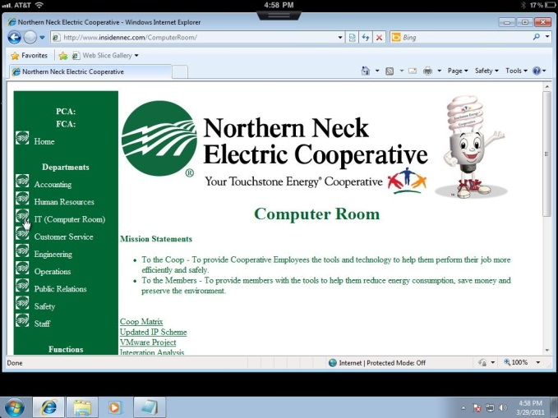
NNEC – iPad & Virtualization
Virtual Desktop, on iPad, using VMware View (3/9/2011)
Normal Desktop
Mapped Drives
Map Viewer
Intranet

Slide 41

Future Apps
eBusiness portal
iOutage (www.ioutage.com)
SmartGrid
SmartHome (www.watchyourwatts.com)
SmartCar

